Slide 1


The Greedy Method and Text Compression
Greedy Method and Compression
Notes:
Merge Sort

Slide 2
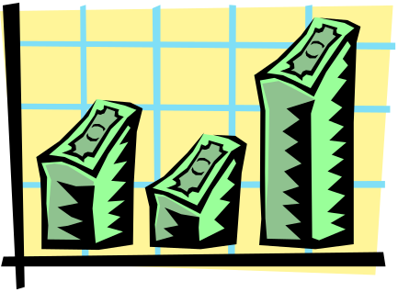
The Greedy Method Technique
The greedy method is a general algorithm design paradigm, built on the following elements:
  configurations: different choices, collections, or values to find
  objective function: a score assigned to configurations, which we want to either maximize or minimize
It works best when applied to problems with the greedy-choice property:
  a globally-optimal solution can always be found by a series of local improvements from a starting configuration.
Greedy Method and Compression

Slide 3
Text Compression
Given a string X, efficiently encode X into a smaller string Y
  Saves memory and/or bandwidth
A good approach: Huffman encoding
  Compute frequency f(c) for each character c.
  Encode high-frequency characters with short code words
  No code word is a prefix for another code
  Use an optimal encoding tree to determine the code words
Greedy Method and Compression

Slide 4
Encoding Tree Example
A code is a mapping of each character of an alphabet to a binary code-word
A prefix code is a binary code such that no code-word is the prefix of another code-word
An encoding tree represents a prefix code
  Each external node stores a character
  The code word of a character is given by the path from the root to the external node storing the character (0 for a left child and 1 for a right child)
00 | 010 | 011 | 10 | 11
a | b | c | d | e
a
d
e
b
c
Greedy Method and Compression

Slide 5
Encoding Tree Optimization
Given a text string X, we want to find a prefix code for the characters of X that yields a small encoding for X
  Frequent characters should have long code-words
  Rare characters should have short code-words
Example
  X = abracadabra
  T₁ encodes X into 29 bits
  T₂ encodes X into 24 bits
T₁
T₂
c
d
b
a
b
r
a
r
c
d
Greedy Method and Compression

Slide 6
Huffman’s Algorithm
Algorithm HuffmanEncoding(X)
Input string X of size n
Output optimal encoding trie for X
C ← distinctCharacters(X)
computeFrequencies(C, X)
Q ← new empty heap
for all c ∈ C
T ← new single-node tree storing c
Q.insert(getFrequency(c), T)
while Q.size() > 1
f₁ ← Q.minKey()
T₁ ← Q.removeMin()
f₂ ← Q.minKey()
T₂ ← Q.removeMin()
T ← join(T₁, T₂)
Q.insert(f₁ + f₂, T)
return Q.removeMin()
Given a string X, Huffman’s algorithm construct a prefix code the minimizes the size of the encoding of X
It runs in time
O(n + d log d), where n is the size of X and d is the number of distinct characters of X
A heap-based priority queue is used as an auxiliary structure
Greedy Method and Compression

Slide 7
Example
11
X = abracadabra
a
6
Frequencies
2
4
a | b | c | d | r
5 | 2 | 1 | 1 | 2
c
d
b
r
6
2
4
a
b
c
d
r
5
2
1
1
2
a
c
d
b
r
5
2
2
4
a
b
c
d
r
a
c
d
b
r
5
2
2
5
Greedy Method and Compression

Slide 8
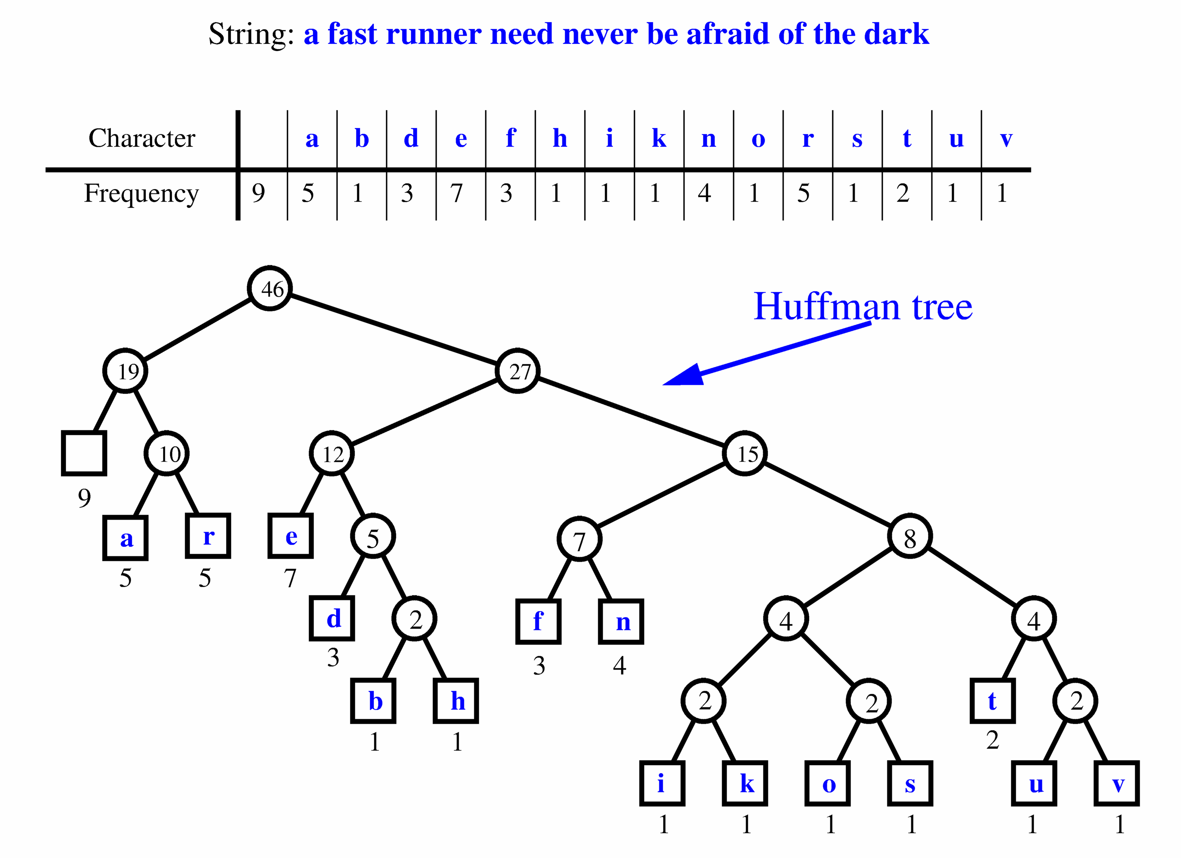
Extended Huffman Tree Example
Greedy Method and Compression

Slide 9


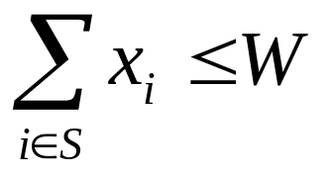
The Fractional Knapsack Problem
Given: A set S of n items, with each item i having
  b_{i} - a positive benefit
  w_{i} - a positive weight
Goal: Choose items with maximum total benefit but with weight at most W.
If we are allowed to take fractional amounts, then this is the fractional knapsack problem.
  In this case, we let x_{i} denote the amount we take of item i
  Objective: maximize
  Constraint:
Greedy Method and Compression

Slide 10

Example
Given: A set S of n items, with each item i having
  b_{i} - a positive benefit
  w_{i} - a positive weight
Goal: Choose items with maximum total benefit but with weight at most W.
“knapsack”
Solution:
1 ml of 5
2 ml of 3
6 ml of 4
1 ml of 2
Items:
1
2
3
4
5
Weight:
4 ml
8 ml
2 ml
6 ml
1 ml
Benefit:
$12
$32
$40
$30
$50
10 ml
Value:
3
4
20
5
50
($ per ml)
Greedy Method and Compression

Slide 11

The Fractional Knapsack Algorithm
Greedy choice: Keep taking item with highest value (benefit to weight ratio)
  Since
  Run time: O(n log n). Why?
Correctness: Suppose there is a better solution
  there is an item i with higher value than a chosen item j, but x_{i}<w_{i}, x_{j}>0 and v_{i}<v_{j}
  If we substitute some i with j, we get a better solution
  How much of i: min{w_{i}-x_{i}, x_{j}}
  Thus, there is no better solution than the greedy one
Algorithm fractionalKnapsack(S, W)
Input: set S of items w/ benefit b_{i} and weight w_{i}; max. weight W Output: amount x_{i} of each item i to maximize benefit w/ weight at most W
for each item i in S
  x_{i} ← 0
  v_{i} ← b_{i} / w_{i} {value}
  w ← 0 {total weight}
  while w < W
  remove item i w/ highest v_{i}
  x_{i} ← min{w_{i} , W - w}
  w ← w + min{w_{i} , W - w}
Greedy Method and Compression

Slide 12

Task Scheduling
Given: a set T of n tasks, each having:
  A start time, s_{i}
  A finish time, f_{i} (where s_{i} < f_{i})
Goal: Perform all the tasks using a minimum number of “machines.”
Machine 3
Machine 2
Machine 1
1
2
3
4
5
6
7
8
9
Greedy Method and Compression

Slide 13
Task Scheduling Algorithm
Greedy choice: consider tasks by their start time and use as few machines as possible with this order.
  Run time: O(n log n). Why?
Correctness: Suppose there is a better schedule.
  We can use k-1 machines
  The algorithm uses k
  Let i be first task scheduled on machine k
  Machine i must conflict with k-1 other tasks
  But that means there is no non-conflicting schedule using k-1 machines
Algorithm taskSchedule(T)
Input: set T of tasks w/ start time s_{i} and finish time f_{i}
Output: non-conflicting schedule with minimum number of machines
m ← 0 {no. of machines}
  while T is not empty
  remove task i w/ smallest s_{i}
  if there’s a machine j for i then
  schedule i on machine j
  else
  m ← m + 1
  schedule i on machine m
Greedy Method and Compression

Slide 14
Example
Given: a set T of n tasks, each having:
  A start time, s_{i}
  A finish time, f_{i} (where s_{i} < f_{i})
  [1,4], [1,3], [2,5], [3,7], [4,7], [6,9], [7,8] (ordered by start)
Goal: Perform all tasks on min. number of machines
Machine 3
Machine 2
Machine 1
1
2
3
4
5
6
7
8
9
Greedy Method and Compression

